Slide 1
Leveraging Public-Private Partnerships to Support Safe Communities
Alicia Jolla
Global Partnerships, Target Corporation
Notes:
Today, both the public and private sector face a real challenge. How do you take a 20th Century model of doing business or policing a community and reform it to meet the demands of a 21st Century society?
With business, we can adapt and change, but in the public sector, change is often difficult.
And this largely stems from the growing structural problems inherited from a century old structural model.
But the thing is, this isn’t just a public sector problem.

Slide 2
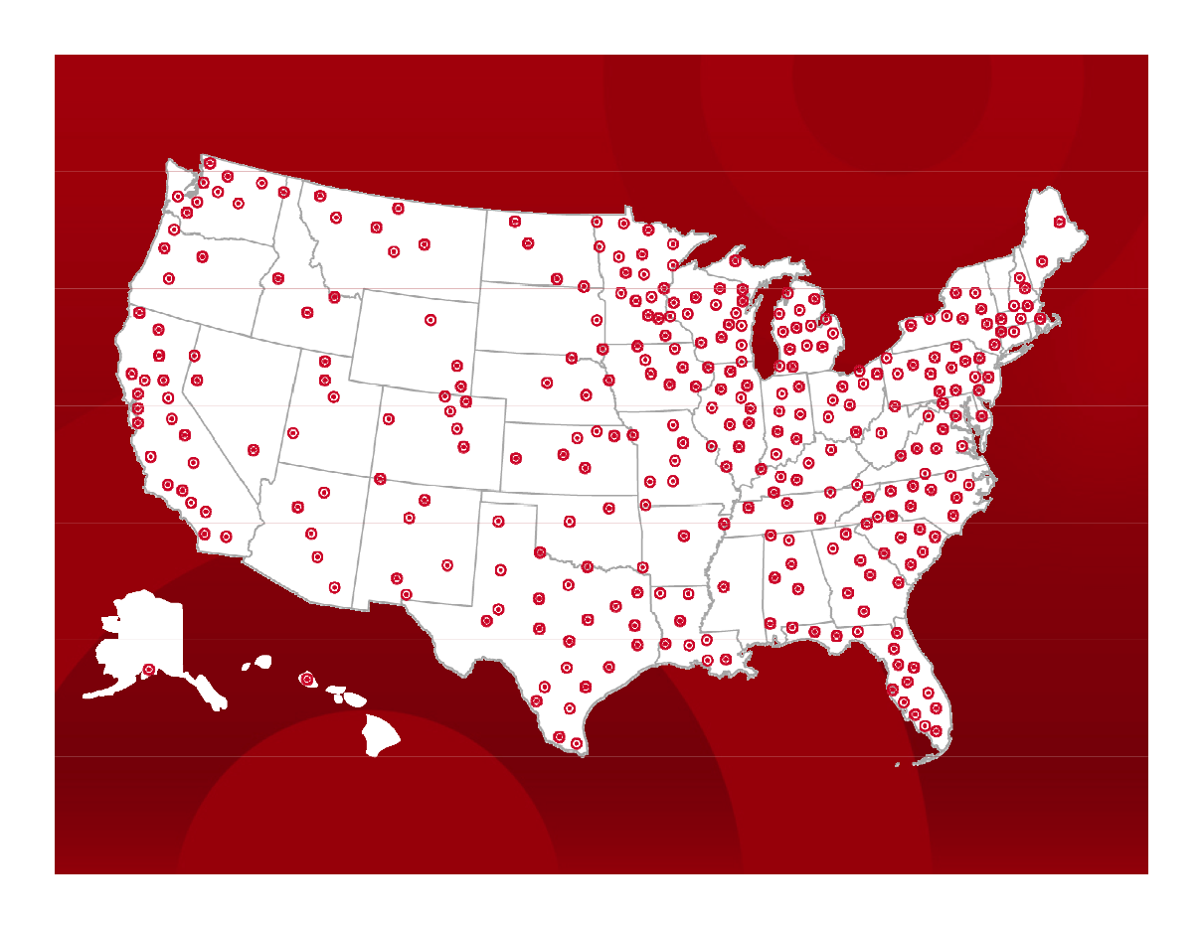
Map of Partnerships Throughout the U.S.

Slide 3
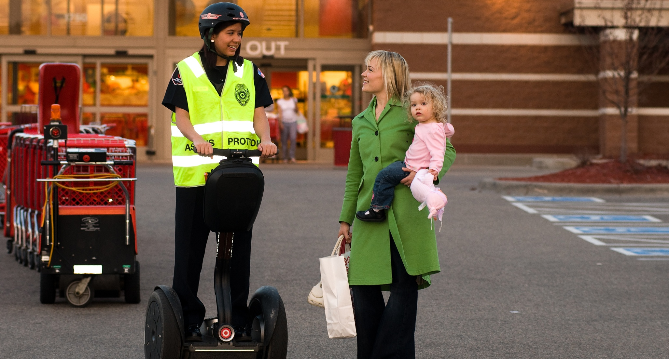

Safety
“Is a place where I feel safe shopping” was the top CSR attribute contributing to store loyalty, making a retailer “One of my favorite places to shop” among respondents
- Q2 2009 Competitive Tracking Survey
Notes:
Our guests consider many things when deciding where to shop and safety is one of them.
She may ask, “Is my family safe while shopping at Target? Can I get essential vaccinations from my Target store? What is Target doing to help my community be safer?”
Safety is a core aspect of our brand
Guests, team members and shareholders continue to see/learn how having a Target in their community makes it safer.

Slide 4
Challenge:
Risk / Resources
RISK
RESOURCES
Notes:
But like any business we have limited resources, and the less resources we have available the more risk we take on for our stores. So we had to find ways to address the risk/resource gap.
Addressing the Risk/Resource Gap
As with any business or organization there are gaps in our resources that challenge our ability to effectively mitigate risk.
To address this gap we focus on four key levers: talent, information, technology and partnerships - which we’ve found to be the most effective way to address risk with limited resources.
Talent: we have a diverse group of people working to address security risks to the company – people with backgrounds in finance, analytics and technology.
Information sharing: we’ve begun to adapt technology and use it more proactively to support safe and secure environments at our facilities and establish connections between related crimes.
Technology: Another important facet to successful risk management is information access and sharing, including intelligence, analytics and all forms of data.
Partnerships:
Partnerships complete an effective security risk management structure.
Private citizens, businesses and police must collaborate to make communities safer.
Our intent isn’t to be the center of these programs, it’s to be a model or catalyst so other companies can see the role they can play and step in to make a change.

Slide 5
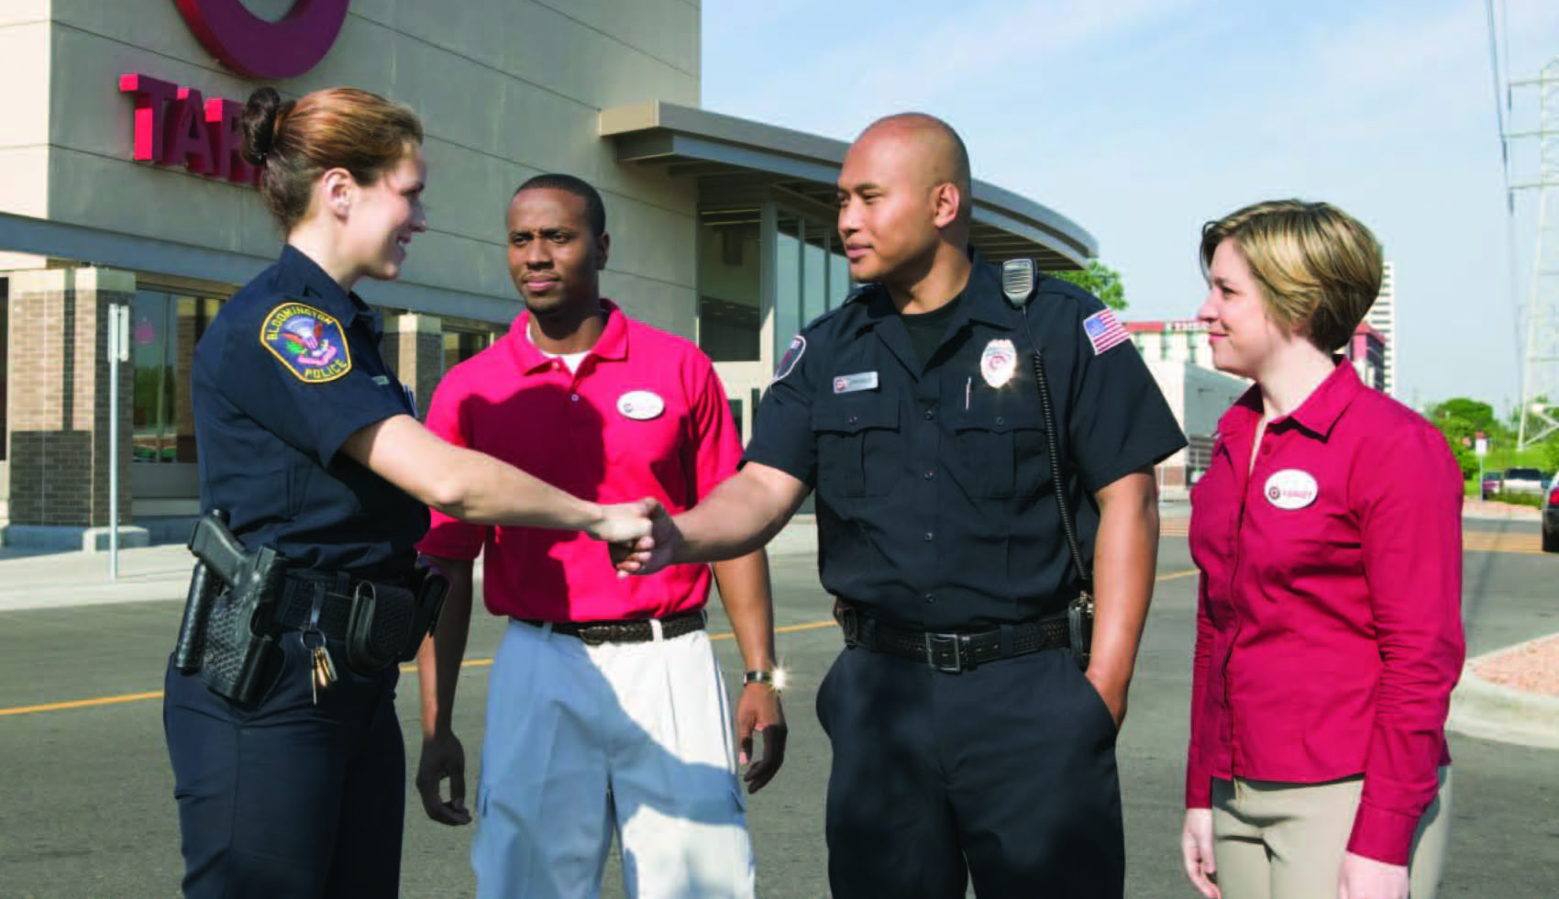
Public-Private Partnerships
Notes:
Public/private partnership programs
Target is an active partner. Our innovative partnerships help create effective public safety solutions by sharing ideas that help prevent crime and prepare communities for disaster.
Traditionally, interactions among law enforcement and retail security groups have taken place under less than positive circumstances. However, our focus on the safety of our team members and guests and our track record of taking an active role in community safety, have enabled us to build trust with our police partners.

Slide 6
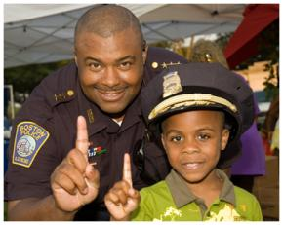
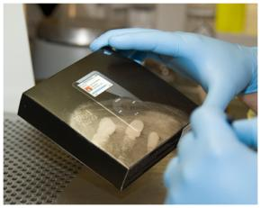
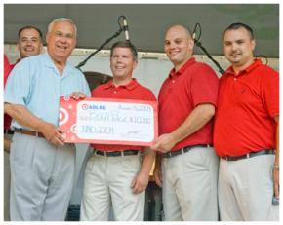
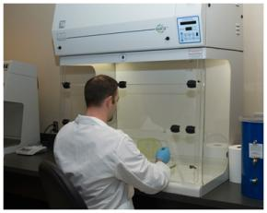

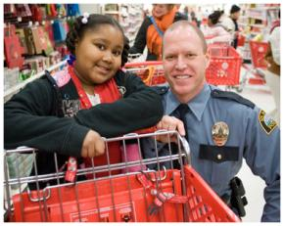
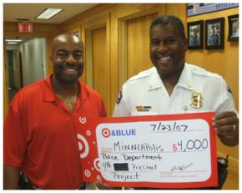
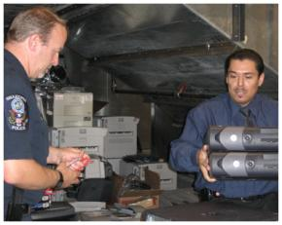
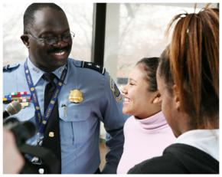
Target and Blue
Notes:
And ultimately, one formal way we found that really works is with our Target and Blue partnership efforts.
Since 1990, Target has supported local law enforcement and public safety agencies across the country by sharing resources and expertise to help build safer, more vibrant communities. We call this partnership effort Target & BLUE® - a public safety partnership to strengthen neighborhoods across the country.
Target & BLUE is part of Target’s commitment to innovative philanthropy. It’s about more than simply writing a check. It’s about partnering with local law enforcement and criminal justice organizations to address safety issues impacting our guests, team members and communities.
We are passionate about the importance of public/private partnerships in everything we do. Law enforcement has always been a critical partner for Target as our highest priority is to provide a safe and secure working and shopping experience for our team members and guests.
Target has significant security resources, from team members to technology. We believe that by sharing those resources and our expertise, together we build safer, more vibrant communities.

Slide 7



Strong Community Citizenship
Target gives 5% of its income to communities – over $3 million every week.
Target.com/community
Notes:
Strong community citizenship is part of our company’s DNA.
Since 1946, Target has given 5 percent of its income to enrich the communities we serve. Today, that giving equals more than $3 million every week.
Community giving is good for business and it’s the right thing to do. We hope our commitment to giving inspires other companies to support philanthropic projects in their communities.
Our giving helps us to make connections with our team members and guests. Our team members enjoy working for a company that gives back to the community.
Our guests feel good about shopping at our stores, knowing that they’re helping kids learn and communities thrive every single time they shop at Target.
Target’s commitment to local communities does not waver based on the economic climate – either good or bad. No matter what, we consistently give 5 percent.

Slide 8
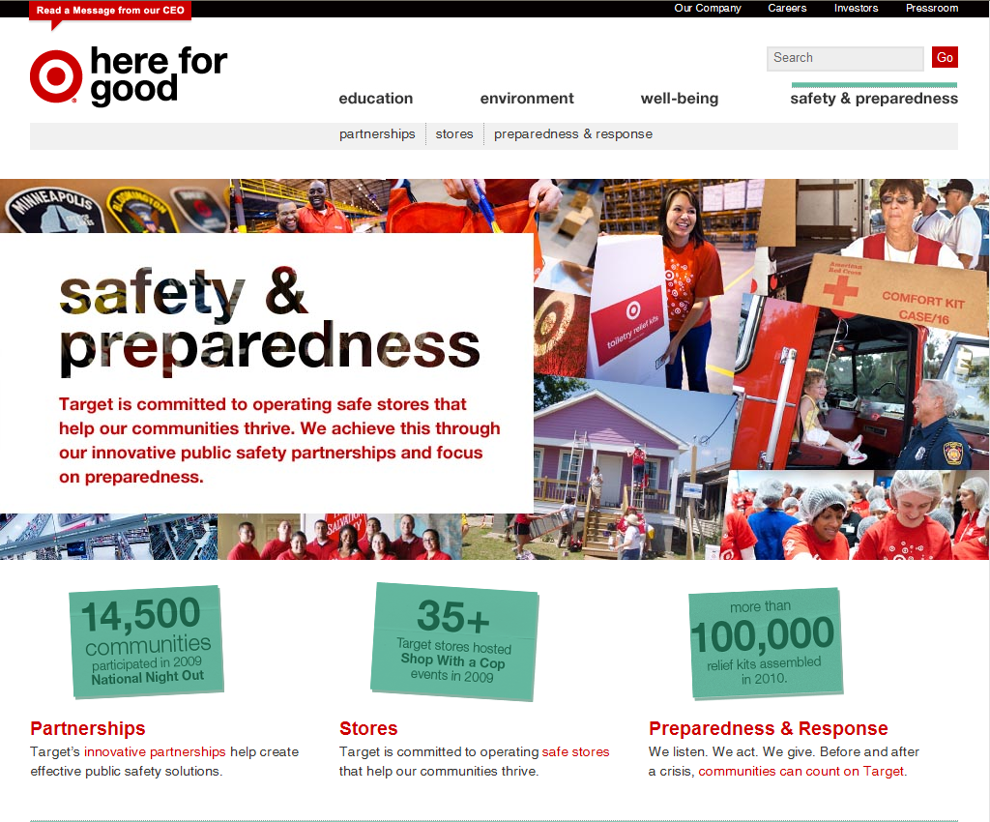
Safety and Preparedness

Slide 9
Why Youth Violence & Safe Communities
Strategic Growth
    Safe Community = Business Opportunity
Reputation – Corporate Social Responsibility
    Brands are Cultural Icons
    CSR Includes community safety
Local Connectivity
    Team Member Engagement
Notes:
There are also many benefits to the foundation model for the public sector.
It allows for ways to help beyond money—it allows for sharing of expertise and a way to be a convener between other organizations, public or private.

Slide 10

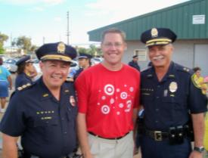
Resources
Grants / Sponsorships
Technology
  Video & computer systems
  Investigative support
Expertise / Best practices
  Training & talent
Convener / Connector
  Publications
  Intellectual philanthropy
Notes:
As part of our partnerships, we offer resources in various forms—from technology to expertise to playing a vital role of connecting and sharing information.

Slide 11
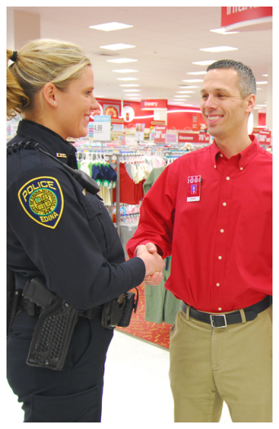
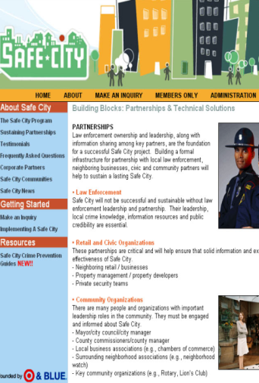
Partnerships and Projects
2000+
Partnerships
20+
Safe City Projects
Notes:
We’ve built many partnerships—and created Safe City Projects in 20+ communities.

Slide 12

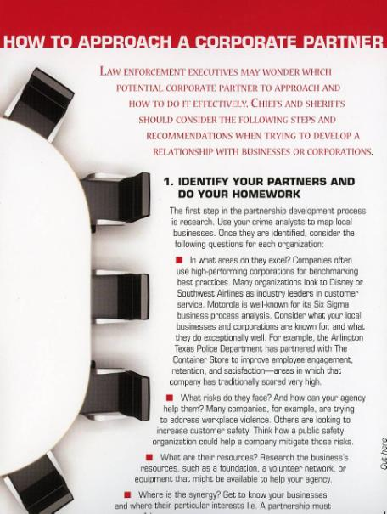
Reaching out to the Private Sector
Notes:
Shared responsibility
PPP
Compton
DOJ COPS Booklet

Slide 13

Discussion

